Slide 1

mXpress
Bi-Weekly Scrum #2
By Team MX
Ranil Fernando, Scott Thomas, Jonathon Florek
2019-10-25

Slide 2

mXpress Emergency Vehicle Routing System
Solving slow emergency response times in large cities
Fills the need for high quality, specialized routing systems for emergency dispatchers
Innovates by utilizing both batch and stream big data coupled with AI to do predictive and reactive trip planning
Potentially allows for consumer vehicle routing using batch data
Adaptable framework allows for multiple qualities of service provided
Notes:
Similar technologies exist, often lacking real time telemetry
Improve emergency service response times in major cities
Yes, technologies exist (public like google maps) and other research projects exist using similar data
Average road speed telemetry
Municipalities/ emergency response/ 911 dispatch
Technology can only be applied in cities with sensors/date collection to provide enough telemetry (toronto)
Discuss from your team’s
Project vision
Project rationale
Envisioned stakeholders
Assumptions and envisioned constraints

Slide 3
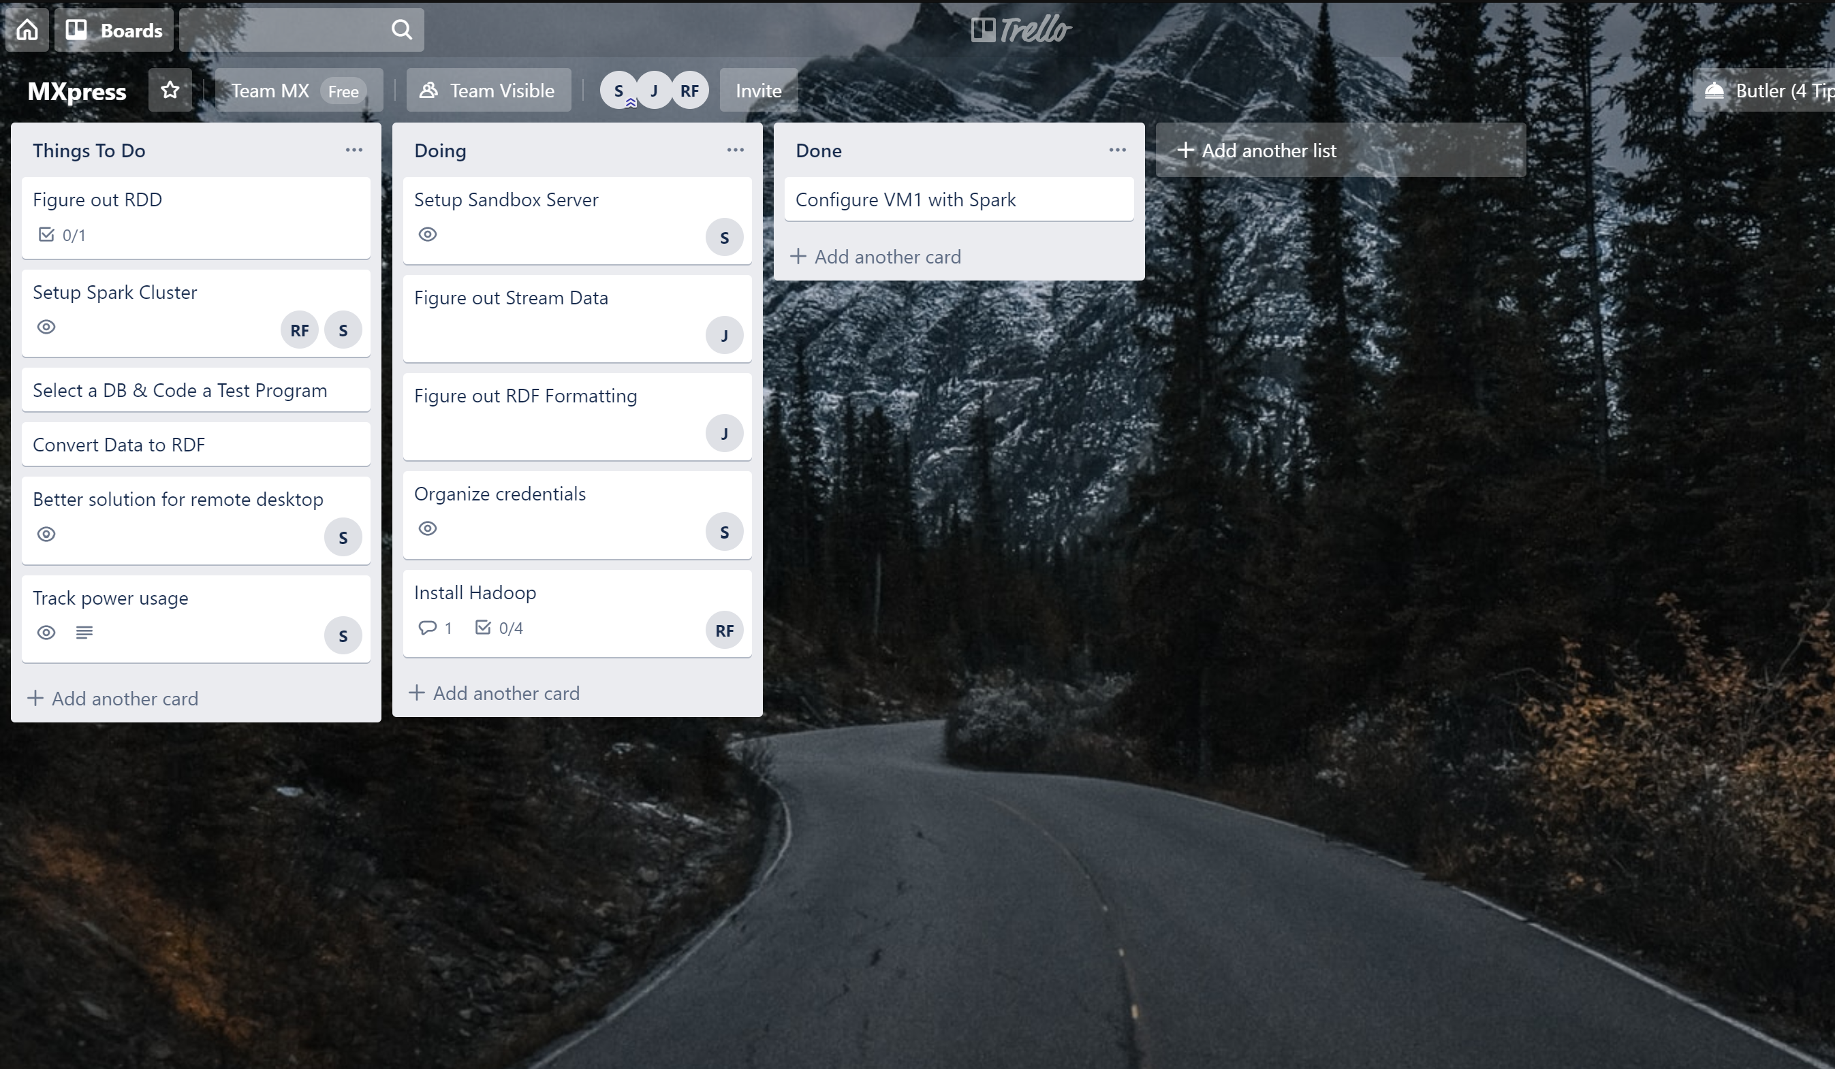
Project Progress
Identified Software Requirements in detail
Created Software Requirements Specification
Testing Backbone Created
Working on Spark programming
Installation of Apache Spark
Have example & test code running on single node Spark
Trello (Kanban Board) & Gantt Chart
Notes:
Created complete document outlining the software requirements, and use cases
Backbone server running Spark now
Currently working on RDD setup and beginning to program for Spark (and clusters)
Already have the test code/examples running

Slide 4


Next Steps
OpenTripPlanner Integration
Creation of RDD (Resilient Distributed Dataset) using ontology
Configuring Spark cluster
MLlib function testing
Apache Hadoop
YARN (Hadoop Daemon Scheduler)
HDFS
Apache Jena
Creation of RDF Database
Scala
Notes:
Need integration of OTP to take our queries of road speed (either stream or batch processed)
RDD is Spark's handling of fault-tolerant data storage across any number of nodes
Will be using it to create new parellelizations of our input data
Also allows integration with any hadoop file system
Create cluster of 3 identical processing VM's to learn load balancing & parellelization of queries
Spark programs need to be written to allow scaling/division of dataset and queries
Integration with built in MLlib functions to allow processing of batch data & predictions

Slide 5
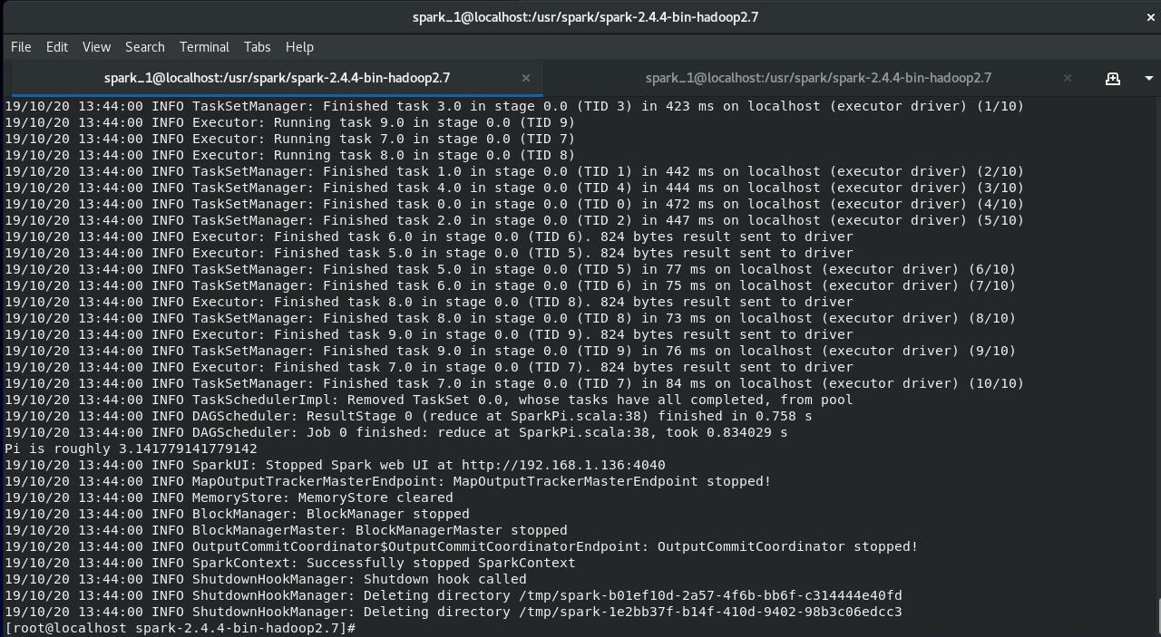
Backbone & Testing
Spark VM1
16GB of RAM & 5 VCores
Functional Apache Spark Node
Running test & example programs
Connection to slave nodes from master
Notes:
Example result from a successful Spark task. (one of the examples from the Apache library)
Currently functional VM running the technologies
Ability to connect to other VM's as slave nodes from a single master node

Slide 6

Group Reflection
Do you feel you are on track?
No, with the discovery of Hadoop being a requirement for Spark this creates a major roadblock to getting a cluster up and running. However with Spark running, we can focus on basic Spark programming as well as integration with OpenTripPlanner
Do you feel there are barriers to your success (if any)?
Lack of documentation
Enterprise grade hardware requirements
Do you need any help going forward?
Nope
Any other questions or concerns?
Nope

